Slide 1





USA
INCOME ANALYSIS
WWW.INCOMEPULSEUNIT.COM

Slide 2


TABLE OF CONTENTS
01
02
03
04
About Us
Our Mission
Project Methodology
Exploring the data
05
06
07
08
Quiz
Detailed
Analysis
Conclusions
Questions

Slide 3



ABOUT US
Data Scientists team, specializing in statistical analysis, machine learning and data visualization.
Our mission is to unravel complex patterns and trends within the vast landscape of socioeconomic data by gender.

Slide 4



PROJECT METHODOLOGY
Presentation and Sharing
Review and Editing
Project Initiation

Slide 5



DATA EXPLORATION
01
Dataset determine whether a person makes over 50K a year or less.
02
Data for the year 1994.
03
Important features: gender, age, native country, education, occupation, marital status

Slide 6


WARM-UP QUIZ
Go to
www.mentimeter.com

Slide 7
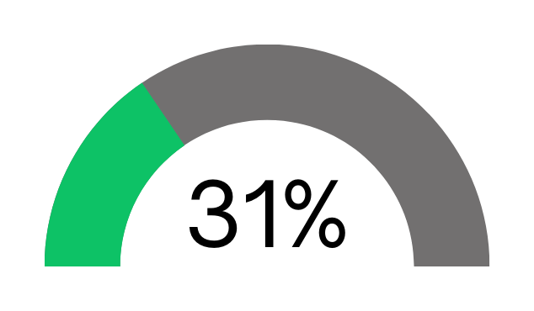
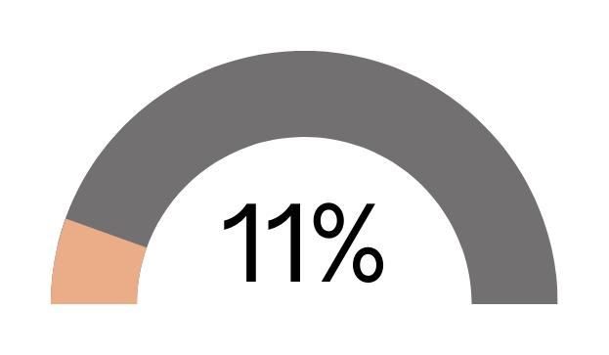
ANALYSIS
Overall High-Income(>$50K) Percentage in MALES
Overall High-Income(>$50K) Percentage in FEMALES

Slide 8
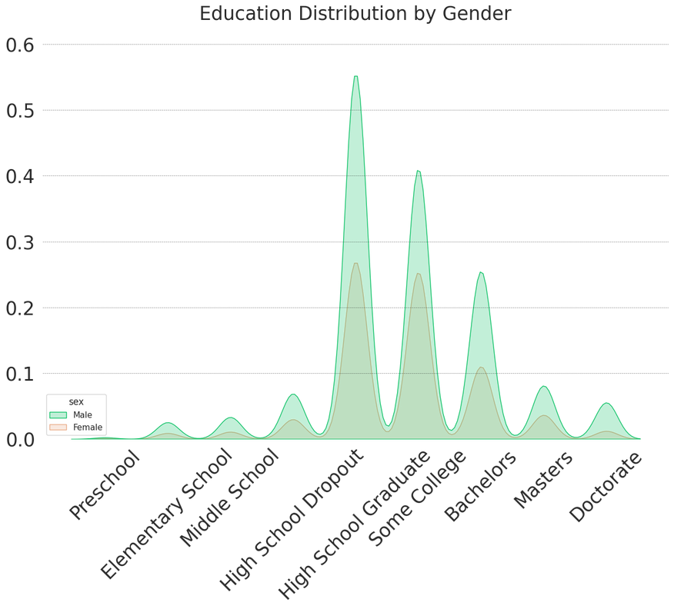
EDUCATION
Overall High-Income(>$50K) Percentage

Slide 9
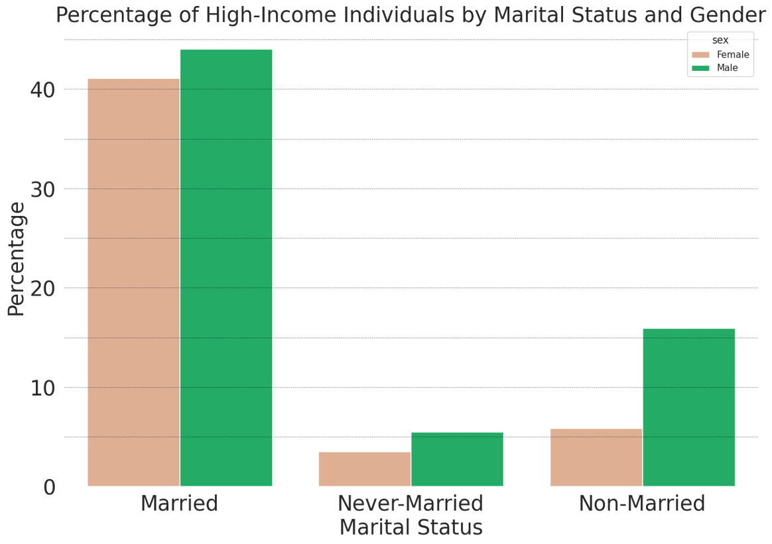
MARITAL STATUS
Overall High-Income(>$50K) Percentage

Slide 10








NATIVE CONTINENT
Asia
Europe
North America
South America

Slide 11






CONCLUSIONS
Women earn less than men in all fields.
Higher education level, smaller disparities.
Women are dependent on marriage.
South Americans earn less, specially women.
INCOME PULSE UNIT

Slide 12








INCOME PULSE UNIT
THANK YOU FOR YOUR ATTENTION

